Slide 1
Python for DevNet Associates
Patrick Rockholz
parockho@cisco.com
Brian Buxton
brbuxton@cisco.com
Systems Architect
Systems Architect

Slide 2

Agenda
Overview
Code Editor vs IDE
Libraries, Pip, virtualenv
Data types
If Statements
Loop Statements
Functions
Code Testing
Challenge Winners & Kahoot

Slide 5
Python is powerful... and fast;
plays well with others;
runs everywhere;
is friendly & easy to learn;
is Open.
https://www.python.org/about/

Slide 6
Why Python for IT Engineers?
Python is a good starting point. (one of the easiest)
it can be interpreted like a script
it is simple and very readable.
Python is a simple language.
was built so that common tasks are easy to accomplish.
Python has a large community of network-based code
many of the tasks we will want to accomplish have already been coded.
Python is extensible.
Whether through libraries and packages, or through the more advanced features of the language itself, Python moves easily from simple tasks to more involved and advanced ones.
Programming for Network Engineers @digital-learning.cisco.com

Slide 7
How to Run Python
Interactive Interpreter
PAROCKHO-M-R0B2:~ parockho$ python3
Python 3.6.4 (default, Jan 6 2018, 11:51:59)
[GCC 4.2.1 Compatible Apple LLVM 9.0.0 (clang-900.0.39.2)] on darwin
Type "help", "copyright", "credits" or "license" for more information.
>>> exit()
PAROCKHO-M-R0B2:~ parockho$

Slide 8
How to Run Python
Scripts
PAROCKHO-M-R0B2:~ parockho$ python3 example1-1.py
def doubler(number):
result = number * 2
return result
get_number = float(input(“Type a number: “))
answer = doubler(get_number)
print(answer)

Slide 9
How to Run Python
IDE (Integrated Development Enviornment
PAROCKHO-M-R0B2:~ parockho$ idle3 -r example1-1.py
def doubler(number):
result = number * 2
return result
get_number = float(input(“Type a number: “))
answer = doubler(get_number)
print(answer)

Slide 10
How to Run Python
Code Editor = a text editor with some syntax highlighting and code formatting capabilities
(e.g. vi/vim, NotePad++, Atom, BBEdit)
https://realpython.com/python-ides-code-editors-guide/

Slide 11
How to Run Python
IDE (Integrated Development Enviornment)
An editor designed to handle code (with, for example, syntax highlighting and auto-completion)
Build, execution, and debugging tools
Some form of source control
(e.g. PyCharm, Visual Studio Code)
https://realpython.com/python-ides-code-editors-guide/

Slide 12
Demo Time!
Notes:
BB - Run through interactive demo live

Slide 13
How to Run Python
A Good Coding Enviornment
The ability to save your code and pick up right where you let off
Run your code within the code enviornment
The capability to “step through” the code for troubleshooting and debugging
Syntax highlighting readability and understanding
Code formatting assistance (e.g. colons, indentations, etc)
https://realpython.com/python-ides-code-editors-guide/

Slide 14
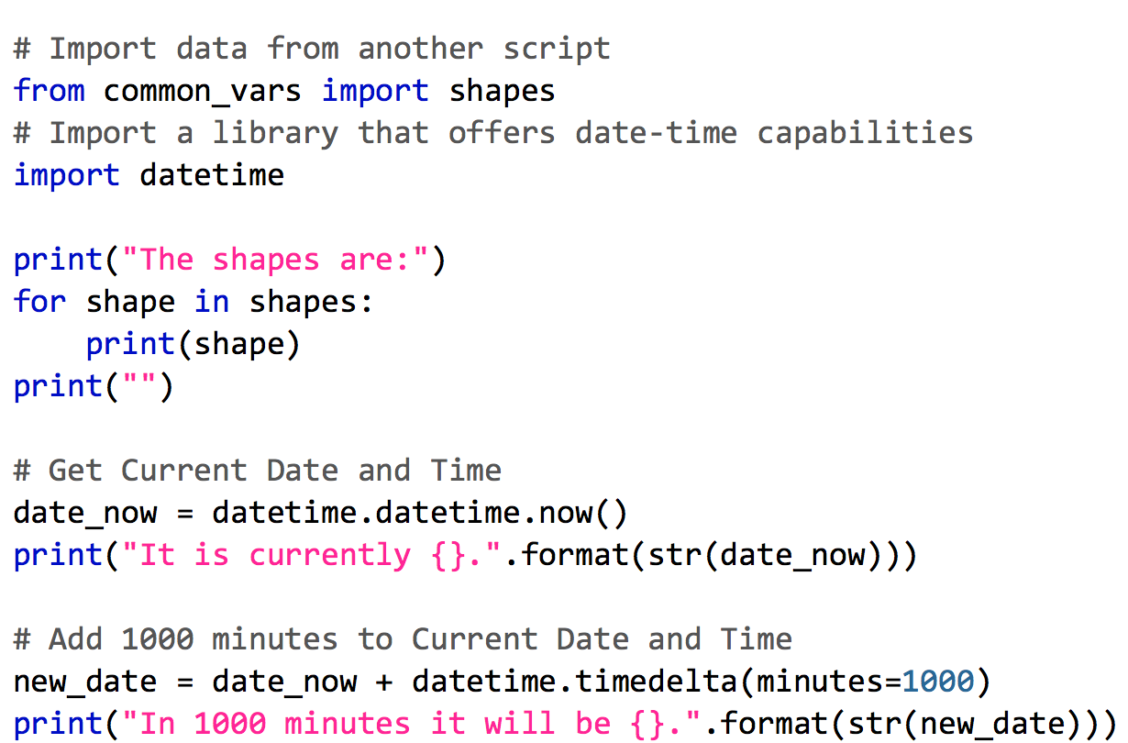
Python Libraries (Modules, Applications, etc)
Any Python code outside of your script you want to use
Provide some capability or data you need
Included with statements
from library import name
import library
netprog_basics/programming_fundamentals/python_part_2/example1.py

Slide 15
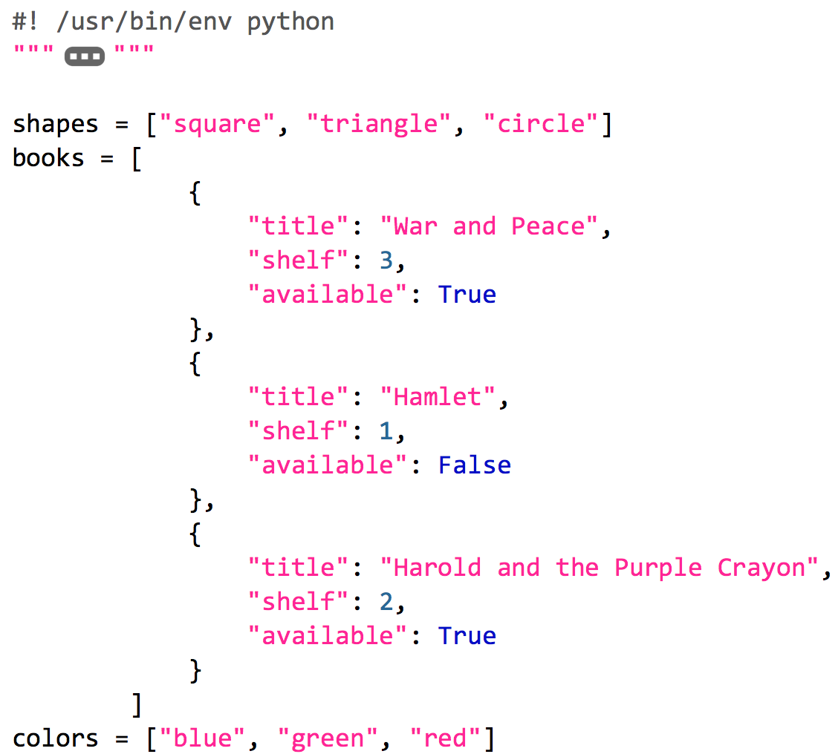
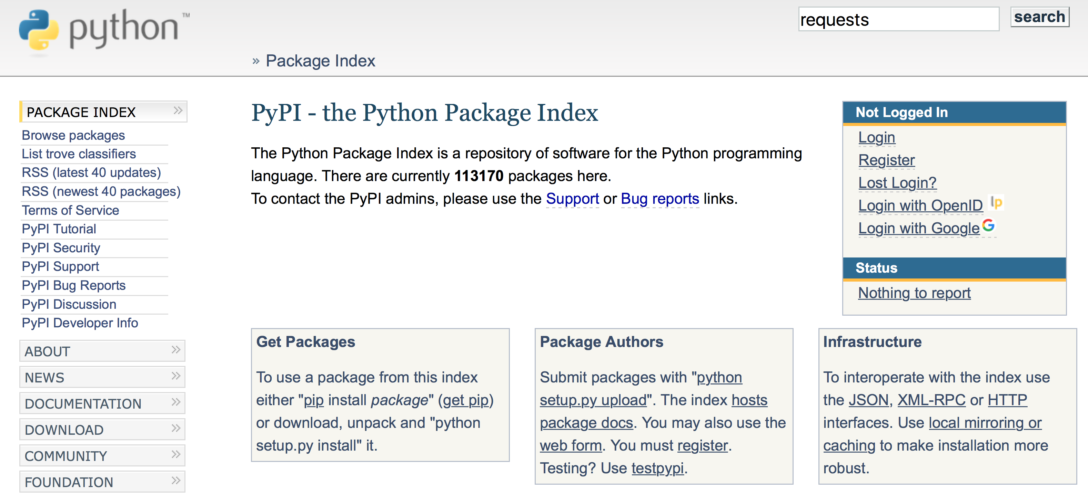
Where to get Libraries
Write them yourself
Example: common_vars
Included with Python itself
Some must be imported (print vs pprint)
Example: datetime, os, sys, json
From Python Package Index (PyPI)
Example: pip install requests
Download and install manually
Example: ACI Toolkit from GitHub
netprog_basics/programming_fundamentals/python_part_2/common_vars.py

Slide 16
Libraries
Python Standard Library
Built-in Library (e.g. print)
Optional (e.g. pprint) so must be imported
Both installed automatically
https://docs.python.org/3/library/index.html
3rd party Libraries (PyPI - the Python Package Index)
Installed and Managed through pip (maintained in site-packages directory)
e.g. pip install requests (a library for REST calls like GET, PUT, etc)
See the list pip freeze
https://pypi.python.org/pypi
Programming for Network Engineers @digital-learning.cisco.com

Slide 17
Pip, The Python Package Installer
Python 2.7.6 and Python 3.4 or greater includes by default
Integrates with PyPI for packages
Install, Upgrade, and Uninstall packages
“requirements.txt” in projects provide input to pip
DevNet$ pip --version
pip 9.0.1
DevNet$ pip install pyang
Collecting pyang
Downloading pyang-1.7.3-py2.py3-none-any.whl (326kB)
100% |████████████████████████████████| 327kB 1.3MB/s
Installing collected packages: pyang
Successfully installed pyang-1.7.3
DevNet$ pip install -r requirements.txt
Collecting requests (from -r requirements.txt (line 1))
Downloading requests-2.18.2-py2.py3-none-any.whl (88kB)
100% |████████████████████████████████| 92kB 662kB/s
.
{OUTPUT TRUNCATED}
.
Successfully installed requests-2.18.2 six-1.10.0 urllib3-1.22
netprog_basics/programming_fundamentals/python_part_2/requirements.txt

Slide 18
pip (and pip3) Commands to Know
Install a package
pip install package
Upgrade a package
pip install --upgrade package
Uninstall a package
pip uninstall package
View all packages installed
pip freeze
Install “requirements.txt”
pip install –r requirements.txt
DevNet$ pip freeze
asn1crypto==0.22.0
bcrypt==3.1.3
certifi==2017.4.17
cffi==1.10.0
chardet==3.0.4
cryptography==2.0
flake8==3.3.0
idna==2.5
lxml==3.8.0
mccabe==0.6.1
ncclient==0.5.3
paramiko==2.2.1
pyang==1.7.3
pyasn1==0.2.3
pycodestyle==2.3.1
pycparser==2.18
pyflakes==1.5.0
PyNaCl==1.1.2
requests==2.18.2
six==1.10.0
urllib3==1.22

Slide 19
What is a Virtual Environment (venv)
Global Enviornment
Used by all .py programs
What if we want different Python versions for testing?
What if we have different library dependencies?
Virtual Enviornment
python3 –m venv [directory name] e.g. python3 –m venv name
Activate – source name/bin/activate
Once done, deactivate

Slide 20
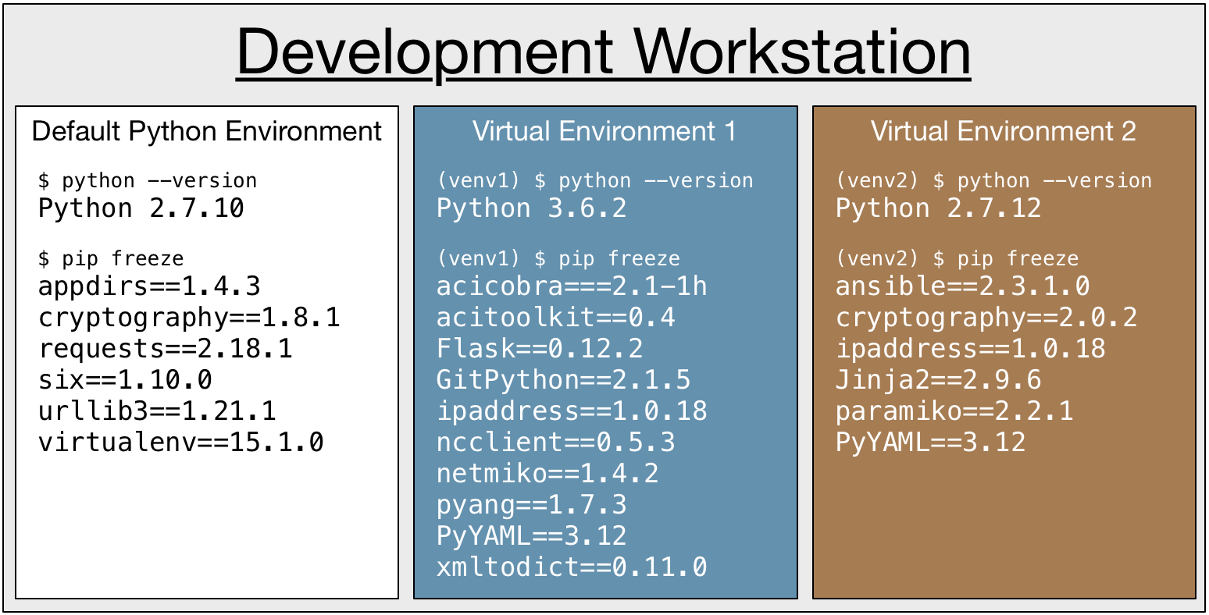
What is a Virtual Environment (venv)
Build isolated, fully functional Python environments on a single workstation
Virtual Environments can
Run different versions of Python
Have different libraries installed
Have different versions of libraries installed

Slide 21
Installing Python Libraries in Virtual Environments
(venv) DevNet$ pip install pyang
Collecting pyang
Downloading pyang-1.7.3-py2.py3-none-any.whl (326kB)
100% |████████████████████████████████| 327kB 1.3MB/s
Installing collected packages: pyang
Successfully installed pyang-1.7.3
(venv) DevNet$ pip install -r requirements.txt
Collecting requests (from -r requirements.txt (line 1))
Downloading requests-2.18.2-py2.py3-none-any.whl (88kB)
100% |████████████████████████████████| 92kB 662kB/s
.
{OUTPUT TRUNCATED}
.
Successfully installed requests-2.18.2 six-1.10.0 urllib3-1.22
Once activated, no different

Slide 22
Demo Time!
Notes:
BB - Run through interactive demo live

Slide 23
Core Python Libraries to Know and Love
Pretty Print
from pprint import pprint
Python Interpreter Utilities
import sys
Operating System Interfaces
import os
Date and Time Utilities
import datetime
* Many libraries included with core Python, see docs

Slide 24
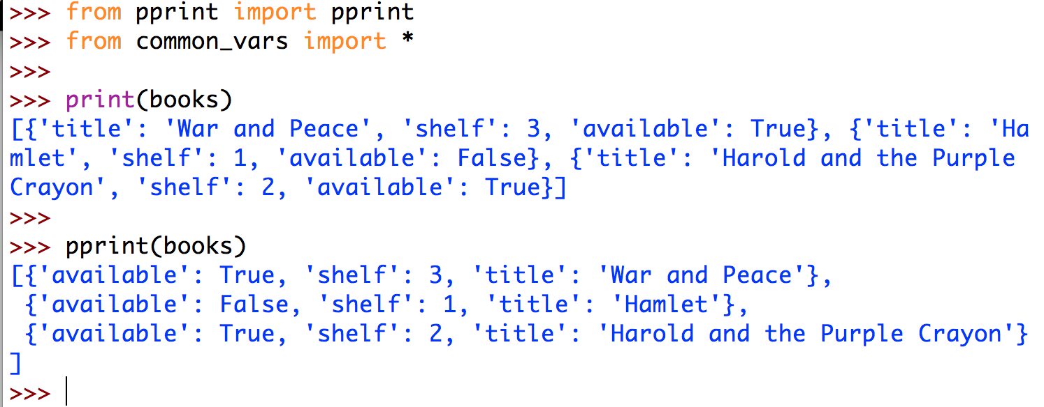
Prettier Printing with pprint
Better formatting than default print() function
https://docs.python.org/3/library/pprint.html

Slide 25
Access Details about Python with sys
DevNet$ python -i common_vars.py "CLI Arg 1" "CLI Arg 2"
>>>
>>> import sys
>>>
>>> sys.argv[1]
'CLI Arg 1'
>>> sys.argv[2]
'CLI Arg 2'
>>>
>>> sys.exit("Error Occurred")
Error Occurred
Access to some details/variables concerning running state
Access command line arguments with sys.argv[]
Access to functions that interact with the interpreter
Exit Python with specific error message sys.exit("Message")
https://docs.python.org/3/library/sys.html

Slide 26
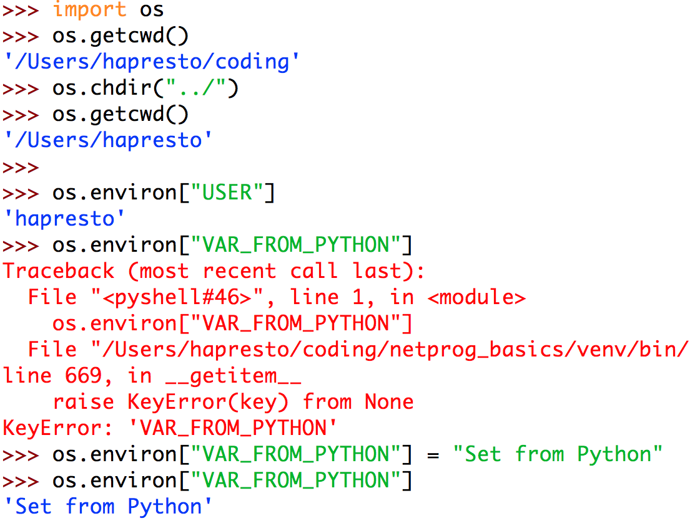
Interact with Files, Paths, and Environment with os
Access and manipulate directories and files
Note: Opening files can be done with open(filename)
Access and Manipulate Environment Variables
os.environ[var_name]
https://docs.python.org/3/library/os.html

Slide 27
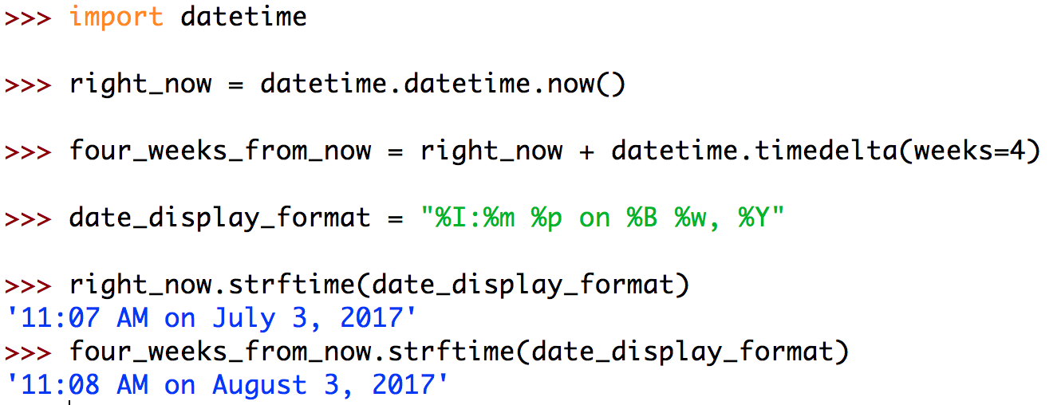
Get your Date and Time Correct with datetime
Create, format, and manipulate dates and times
Time arithmetic!
Work with timestamps and other representations
https://docs.python.org/3/library/datetime.html

Slide 28
Manipulating Data of All Formats
XML - xmltodict
pip install xmltodict import xmltodict
JSON
import json
YAML - PyYAML
pip install PyYAML import yaml
CSV
import csv

Slide 29
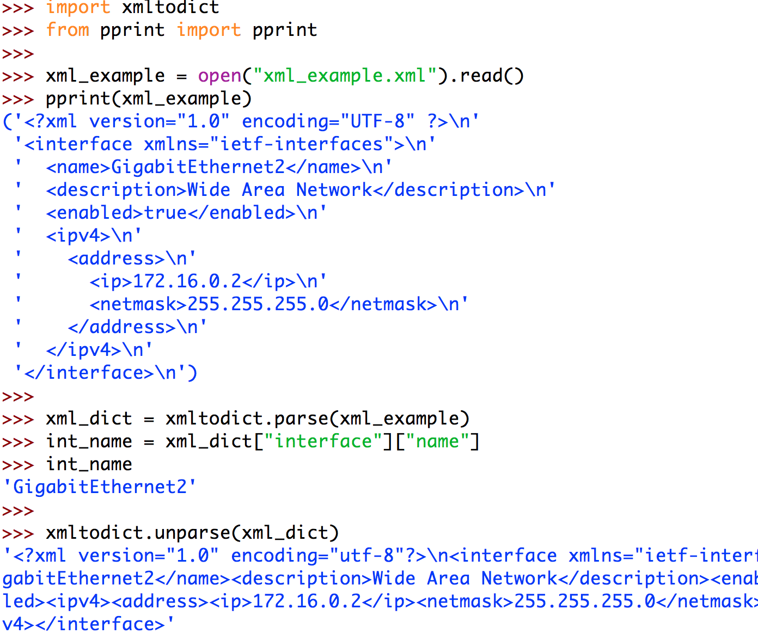
Treat XML like Python Dictionaries with xmltodict
Easily work with XML data
Convert from XML -> Dict* and back
xmltodict.parse(xml_data)
xmltodict.unparse(dict)
Python includes a native Markup (html/xml) interfaces as well
More powerful, but also more complex
* Technically to an OrderedDict
https://pypi.python.org/pypi/xmltodict
netprog_basics/programming_fundamentals/python_part_3/xml_example.xml

Slide 30
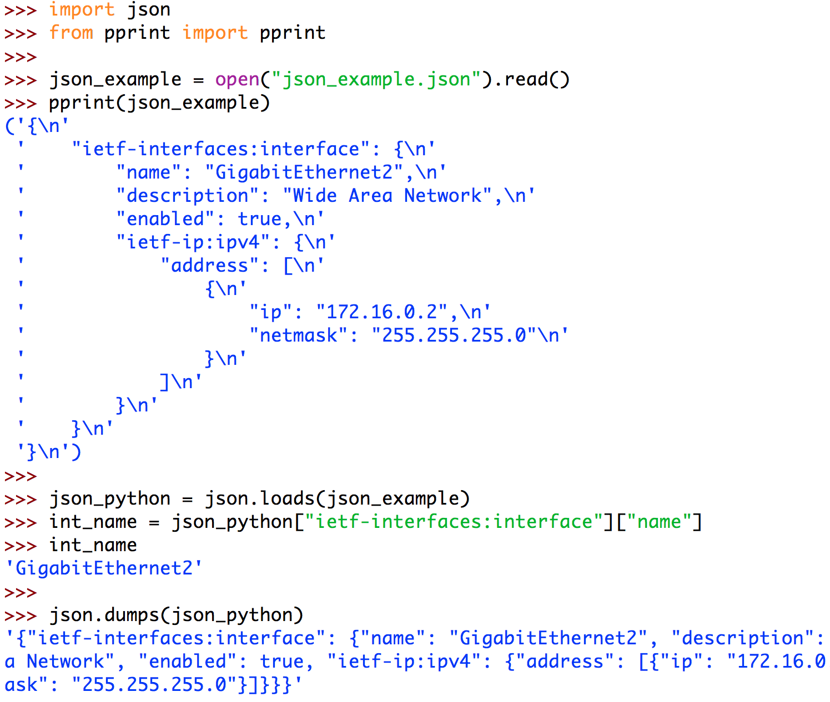
To JSON and back again with json
JSON and Python go together like peanut butter and jelly
json.loads(json_data)
json.dumps(object)
JSON Objects convert to Dictionaries
JSON Arrays convert to Lists
https://docs.python.org/3/library/json.html
netprog_basics/programming_fundamentals/python_part_3/json_example.json

Slide 31
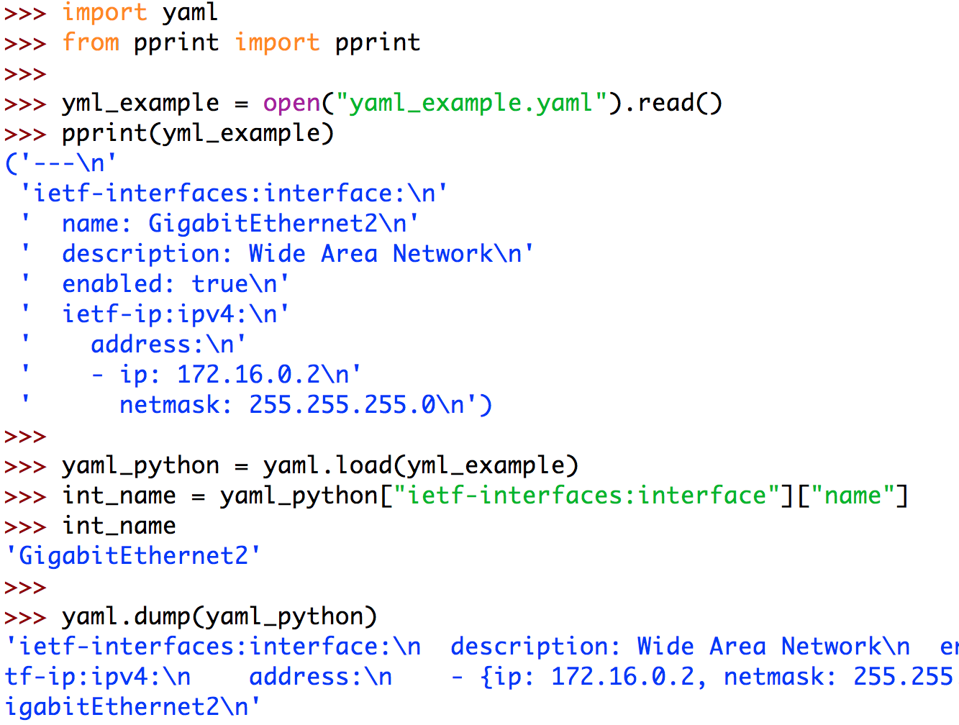
YAML? Yep, Python Can Do That Too!
Easily convert a YAML file to a Python Object
yaml.load(yaml_data)
yaml.dump(object)
YAML Objects become Dictionaries
YAML Lists become Lists
https://pypi.python.org/pypi/PyYAML/3.12
netprog_basics/programming_fundamentals/python_part_3/yaml_example.yaml

Slide 32
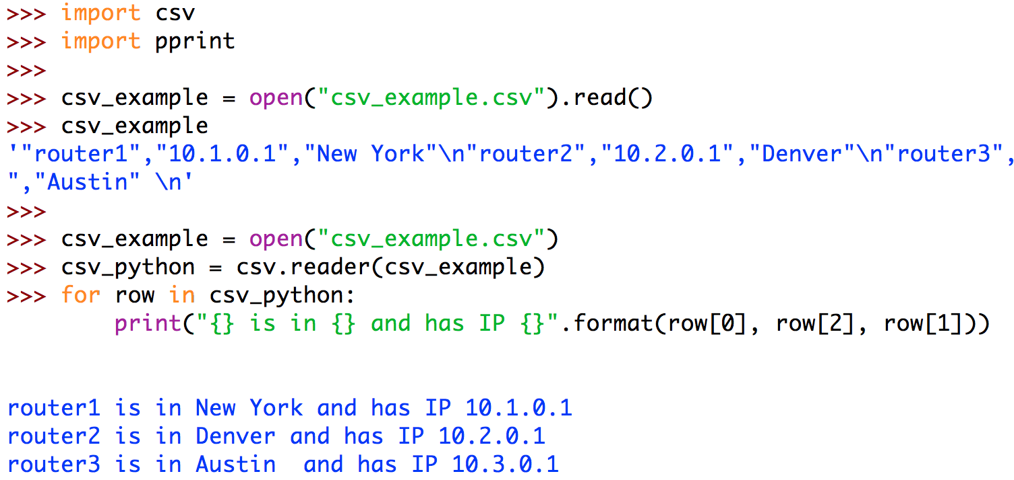
Import Spreadsheets and Data with csv
Treat CSV data as lists
csv.reader(file_object)
Efficiently processes large files without memory issues
Options for header rows and different formats
https://docs.python.org/3/library/csv.html
netprog_basics/programming_fundamentals/python_part_3/csv_example.csv

Slide 33
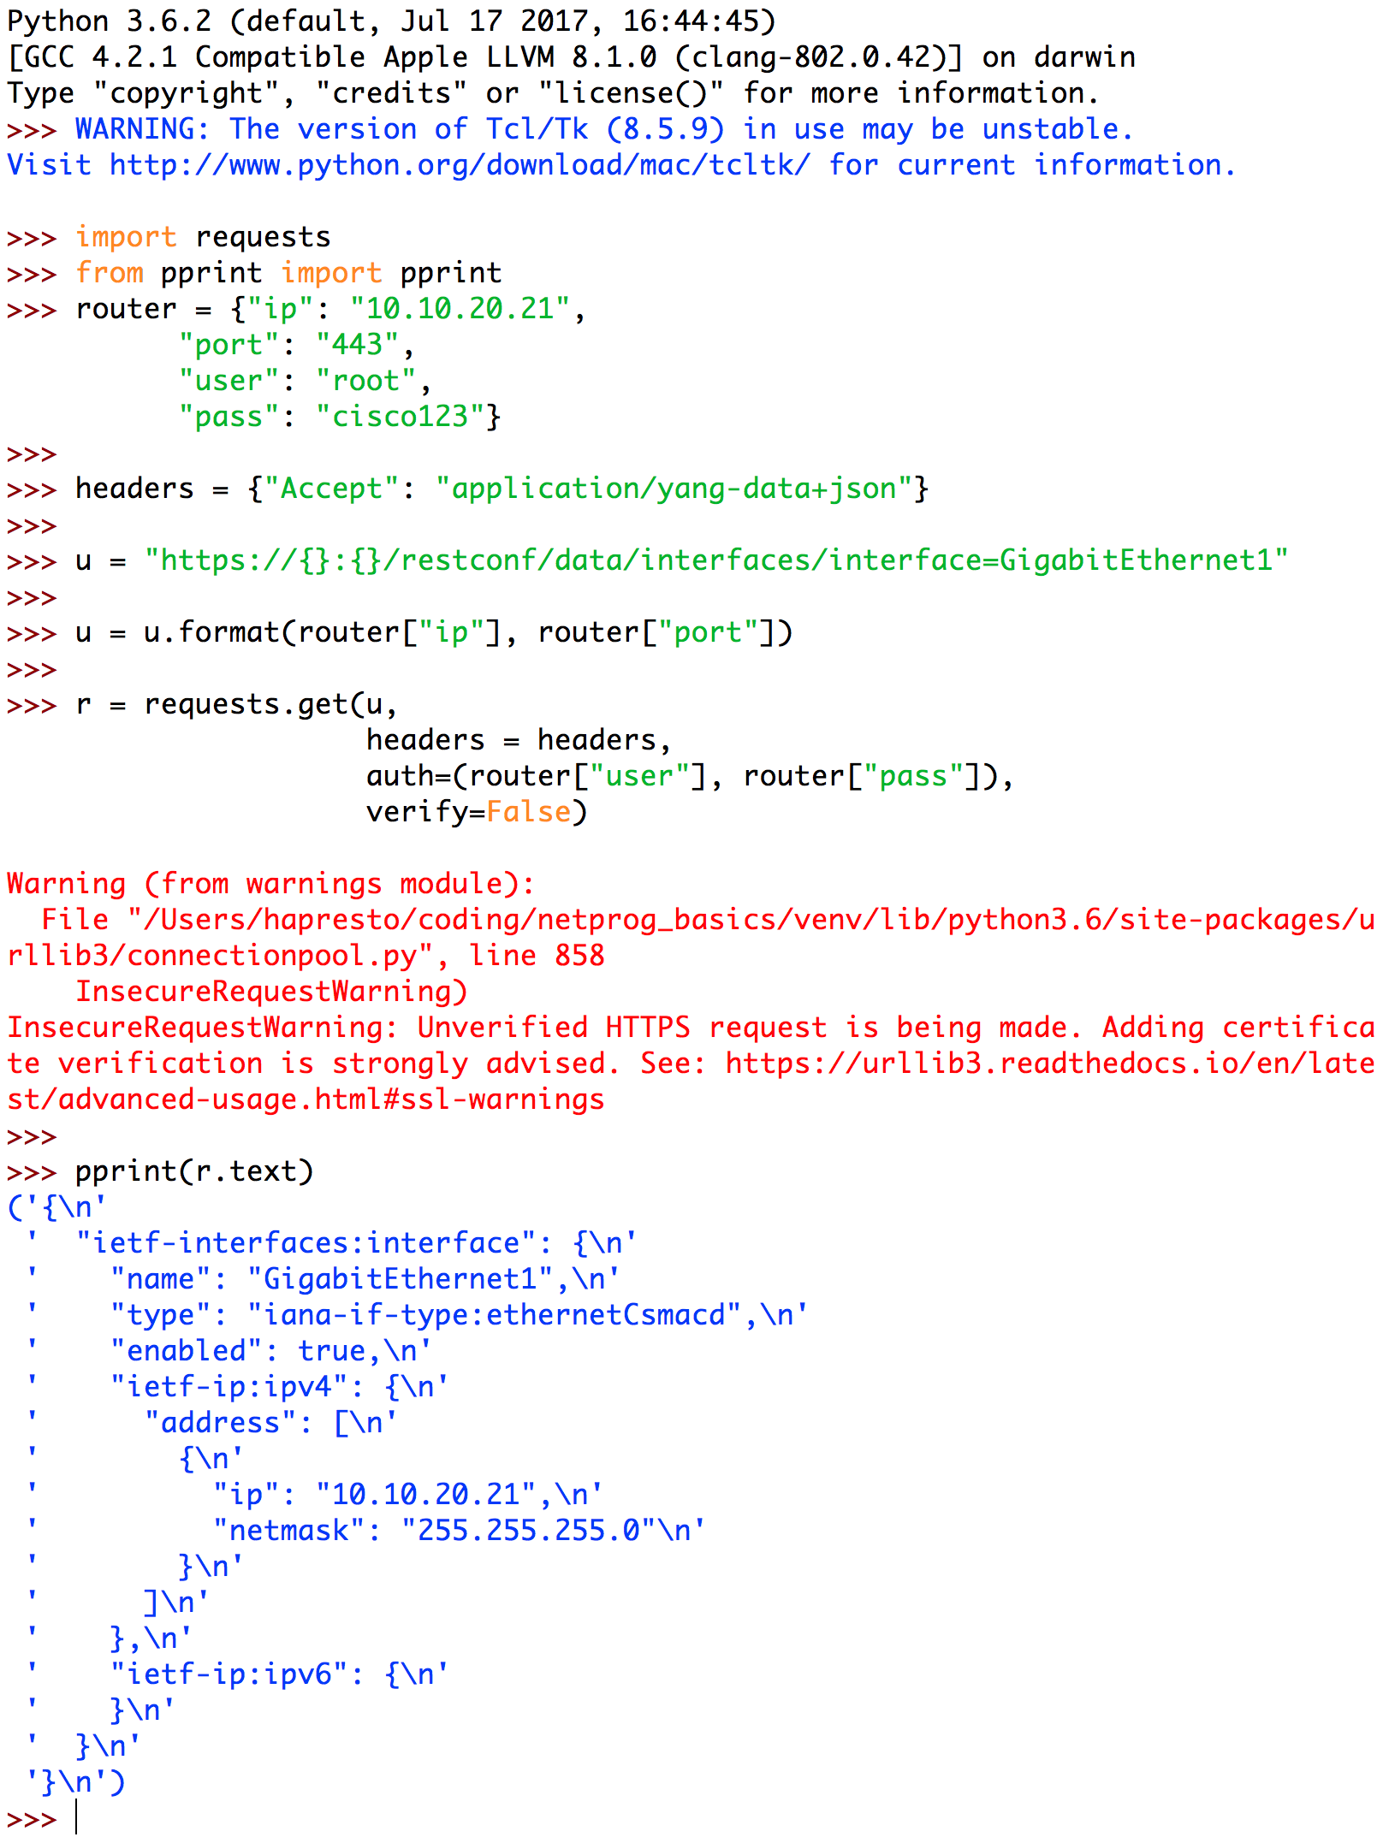
Make HTTP Calls with Ease using requests
Full HTTP Client
Simplifies authentication, headers, and response tracking
Great for REST API calls, or any HTTP request
http://docs.python-requests.org
netprog_basics/programming_fundamentals/python_part_3/api_requests_example.py

Slide 34
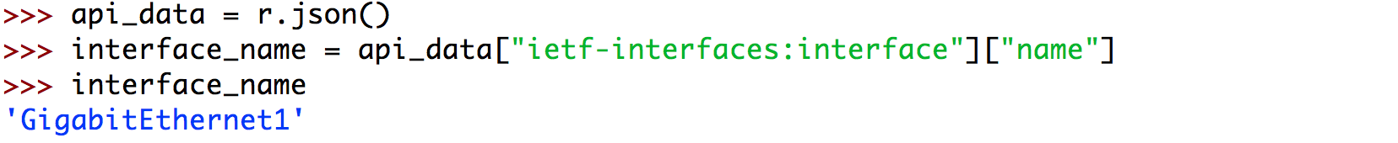
Make HTTP Calls with Ease using requests
Full HTTP Client
Simplifies authentication, headers, and response tracking
Great for REST API calls, or any HTTP request
http://docs.python-requests.org
netprog_basics/programming_fundamentals/python_part_3/api_requests_example.py

Slide 35
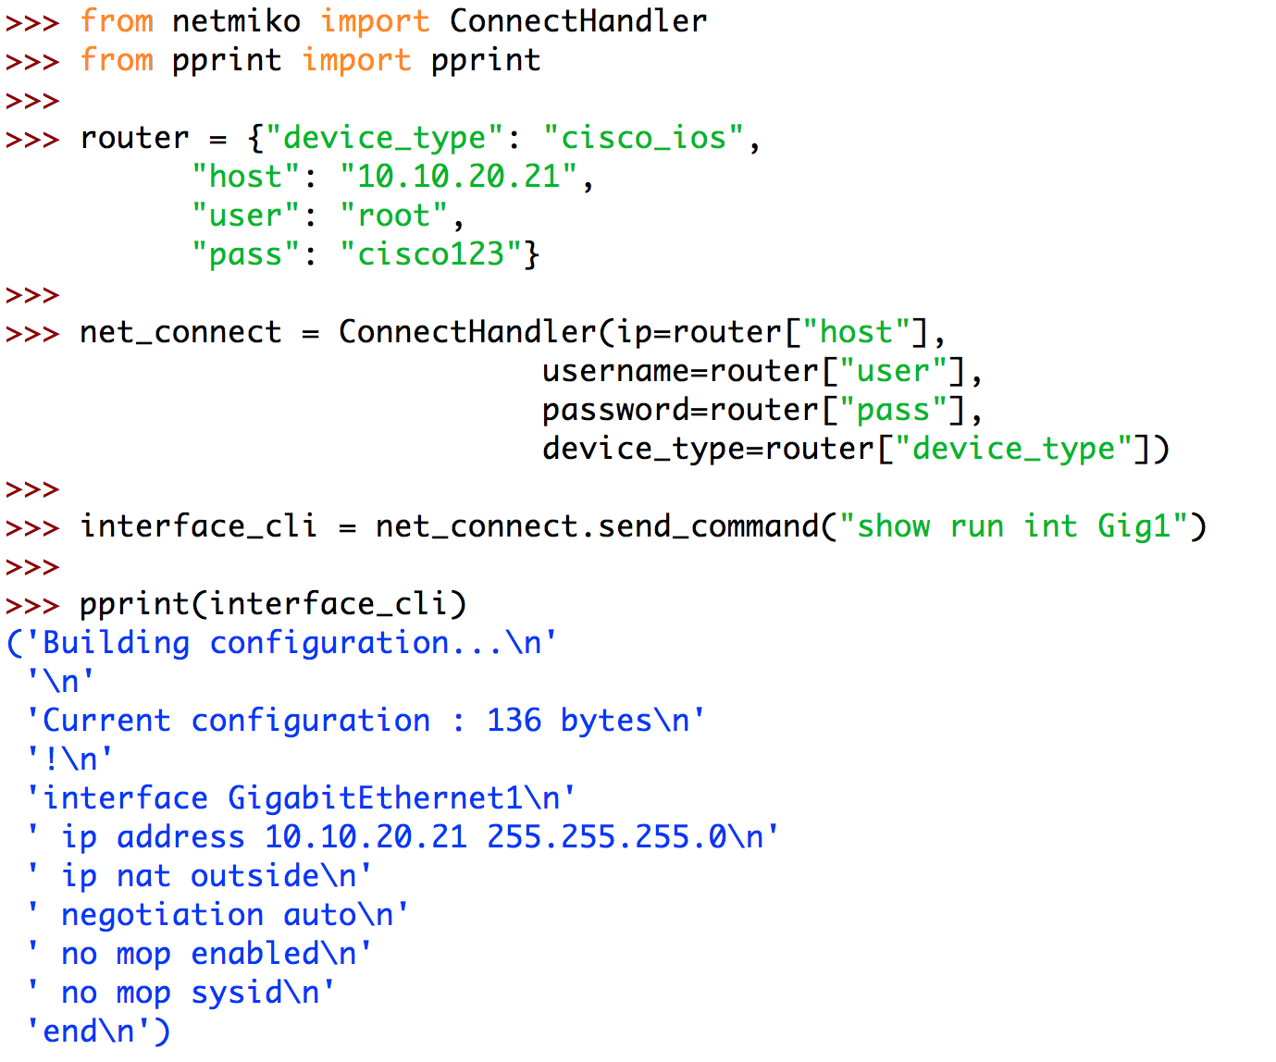
For When CLI is the Only Option – netmiko
If no other API is available…
Builds on paramiko library for SSH connectivity
Support for a range of vendors network devices and operating systems
Send and receive clear text
Post processing of data will be key
https://github.com/ktbyers/netmiko
netprog_basics/programming_fundamentals/python_part_3/api_netmiko_example.py

Slide 36
Data Types
Strings - a series of characters, surrounded by single or double quotes.
“And now for something completely different…”
"hello"+"world" "helloworld" # concatenation
"hello"*3 "hellohellohello" # repetition
"hello"[0] "h" # indexing
"hello"[-1] "o" # (from end)
"hello"[1:4] "ell" # slicing
len("hello") 5 # size
"hello" < "jello" True # comparison
"e" in "hello" True # search

Slide 37
Data Types
String Functions
str.lower(string) - lowercase version of a string
str.upper(string) - uppercase version of a string
str.isalpha(string) - True if the string has only alpha chars
Many others: split, replace, find, format, etc.

Slide 38
Printing with strings
Format method
Default_dinner = ”chicken"
print ("I’m in the mood for {} tonight.".format(Default_dinner))
>>>I’m in the mood for chicken tonight.
F-strings (version 3.6+)
Default_dinner = ”chicken"
print (f"I’m in the mood for {Default_dinner} tonight.")
>>>I’m in the mood for chicken tonight.

Slide 39
Data Types
Numbers
Integer
100
1000
10000
0xff
Float
15.5
1234.567
Notes:
BB

Slide 40
Data Types
Numbers
Arithmetic operators we will use:
+ - * / addition, subtraction/negation, multiplication, division
% modulus, a.k.a. remainder
** exponentiation
precedence: Order in which operations are computed.
* / % ** have a higher precedence than + - 1 + 3 * 4 is 13
Parentheses can be used to force a certain order of evaluation. (1 + 3) * 4 is 16
Notes:
BB

Slide 41
Data Types
Numbers
When integers and reals are mixed, the result is a real number.
Example: 1 / 2.0 = 0.5
Notes:
BB

Slide 42
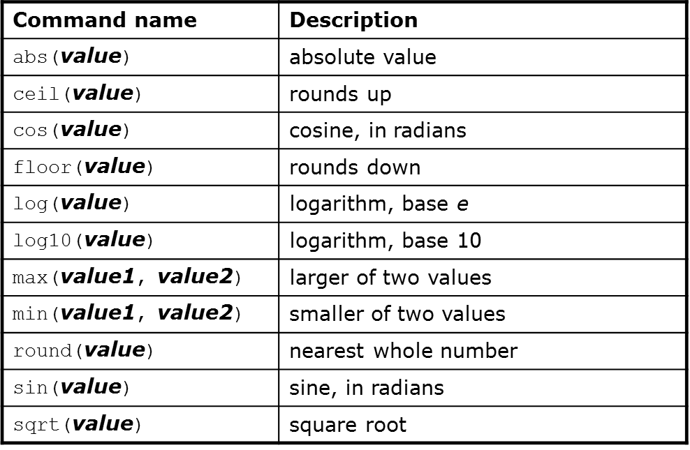
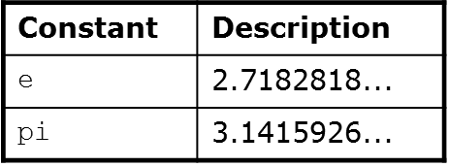
Data Types
Math Functions
Use this at the top of your program:
from math import *
Beginning Python
42
Notes:
BB

Slide 43
Data Types (cont.)
Lists (think square) – stores items in a particular order
Sequenced: Ordered sequential list of items
Heterogeneous: Items in a list can be of different types
Mutable: Items can be added, removed, inserted, popped, and sorted
Items: List items can be data structures, to create lists of lists, lists of dictionaries or lists of tuples
MyList = [123, ’Hi’, [‘apple’, ‘banana’, ‘orange’], conf_file]

Slide 44
Data Types (cont.)
Dictionaries (think curly)
Unordered: Not sequenced, accessed by key (fast lookup)
Keys: Key must be immutable & hashable—string, numeric, or tuple
Key:Value pairs
Mutable: Items can be added, removed, or changed
Items: Items can be simple or complex
device1 = {"ip":"10.3.21.5", "version":"A.01.01","username":"user1","password":"pw1”}
K
V
(doesn’t this look like JSON??)
K
V
K
V
K
V
Notes:
BB

Slide 45
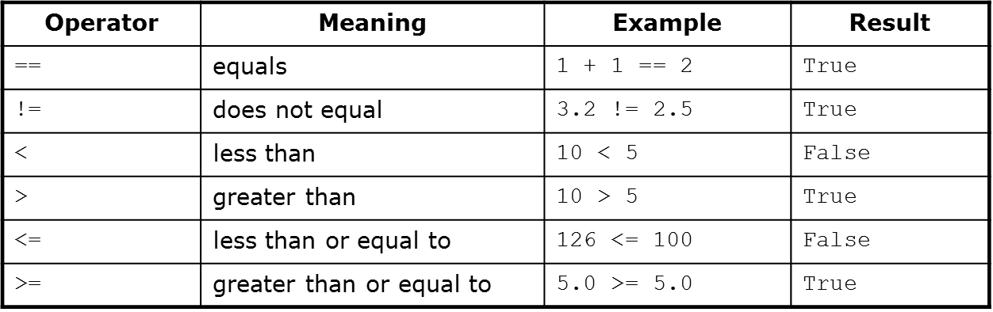
Booleans
A boolean value is either True or False. Variables with boolean values are often used to keep track of certain conditions within a program
Relational Operators

Slide 46
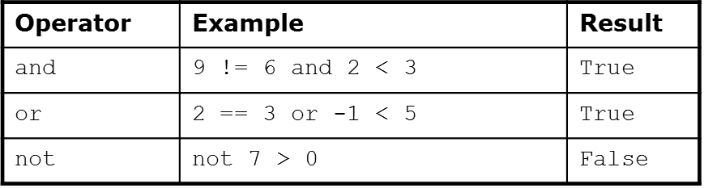
Booleans
A boolean value is either True or False. Variables with boolean values are often used to keep track of certain conditions within a program
Logical Operators

Slide 47
If Statements
Used to test for particular conditions and respond appropriately
Can be nested
Watch out for indentions/white space – this affects scope
Syntax:
if <condition>:
<statements>
x = 5
if x > 4:
print(“x is greater than 4”)
print(“This is not in the scope of the if”)
Notes:
BB

Slide 48
If Statements (cont.)
if expression:
statement(s)
elif expression:
statement(s)
else:
catchall
Notes:
BB

Slide 49
Loops
For Loops are used to repeat a specific block of code a known number of times.
While loops run as long as certain conditions remaintrue
for statement
for [variable] in [sequence]:
do something
while statement
while True:
do something
Notes:
The for statement is used to iterate over the elements of a sequence (such as a string, tuple or list) or other iterable object
The while statement is used for repeated execution as long as an expression is true:

Slide 50
Functions
Functions are named blocks of code designed to do one specific job. They allow you to write code once that can then be run whenever you need to accomplish the same task. Functions can take in the information they need, and return the information they generate.
Example:
def my_function(x):
do something
return something ⬅ This is optional
Notes:
BB

Slide 51
Python TDD with pytest
# content of test_step.py
import pytest
class TestUserHandling:
def test_login(self):
pass
def test_modification(self):
a = 2
b = 3 - 1
assert (a == b)
def test_deletion(self):
pass
def test_normal():
pass
Notes:
BB

Slide 52
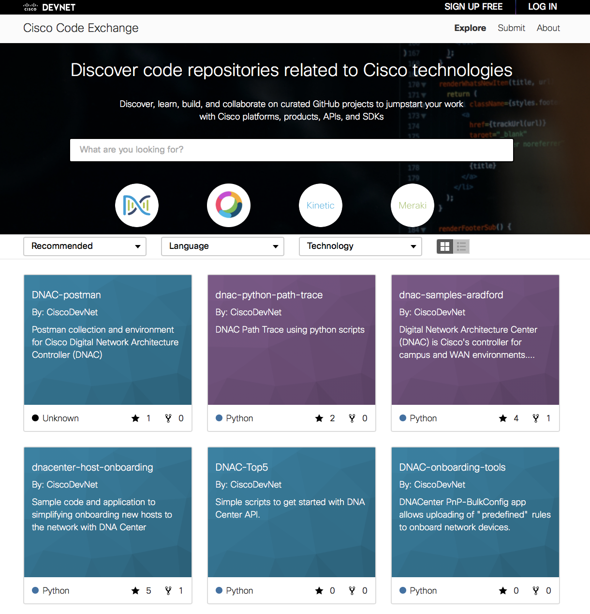
DevNet Code Exchange
Curated software built around Cisco platforms & APIs
Sample code
Connectors
Open source
Built on GitHub
Software written by the community
Connect to expert developers
https://developer.cisco.com/codeexchange

Slide 53
Python Challenge
Brad Ferguson
Bryce Breedlove
Buford Peek
Nick Grants
Bradley Knopps

Slide 55
Try Statements
Python.org definition:
First, the try clause (the statement(s) between the try and except keywords) is executed.
If no exception occurs, the except clause is skipped and execution of the try statement is finished.
If an exception occurs during execution of the try clause, the rest of the clause is skipped. Then if its type matches the exception named after the exceptkeyword, the except clause is executed, and then execution continues after the try statement.
If an exception occurs which does not match the exception named in the except clause, it is passed on to outer try statements; if no handler is found, it is an unhandled exception and execution stops with a message as shown above.

Slide 56
Try Statements (cont.)
try:
try executing something
except Exception as e:
do something when the try fails
else:
happens when the try statement passes

Slide 57
Questions?

